Slide 1
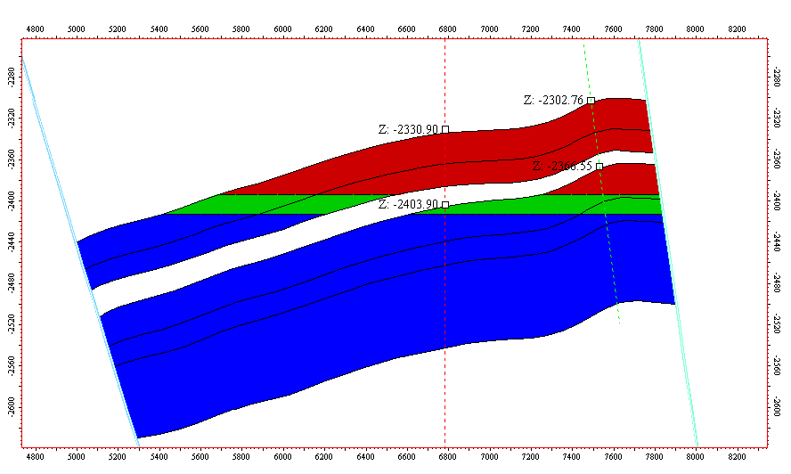


Cross section showing various sands form North to South
*note: Reservoir quality improves Northwards
N
Possible
Appraisal well
S
Bilabri-1
Bilabri-DX1
2303
C1.1
2331
C1.2
2367
C2.1
2404
C2.2
C2.3
Proximal
Macrostructure boundary fault

Slide 2
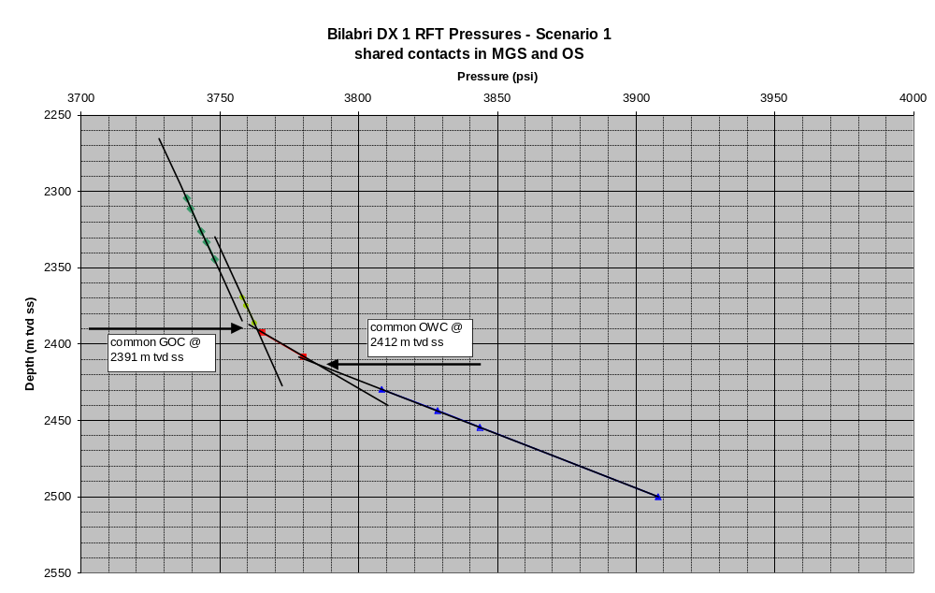
Pressure Plot – Scenario 1: Shared GOC & OWC

Slide 3

Cross section showing Oil-Gas distribution – Shared GOC & OWC
*note: Reservoir quality improves Northwards
N
Possible
Production well
S
Bilabri-1
Bilabri-DX1
Gas
Oil
2303
Intersection GOC with seat seal
C1.1
2331
C1.2
2367
C2.1
GOC: 2391
2404
C2.2
OWC: 2412
C2.3
Proximal
Macrostructure boundary fault

Slide 4
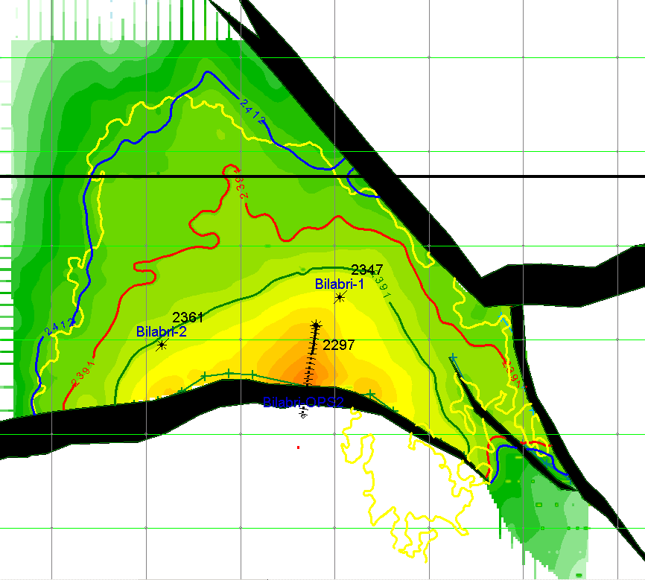
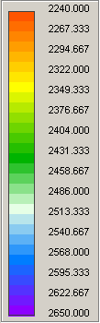
Map of MGS showing: Shared GOC & OWC
OWC = 2412 TVD ss
GOC = 2391 TVD ss
Intersection GOC with seat seal
= 2391 TVD ss
Amplitude anomaly outline
Possible production well
Bilabri-4

Slide 5
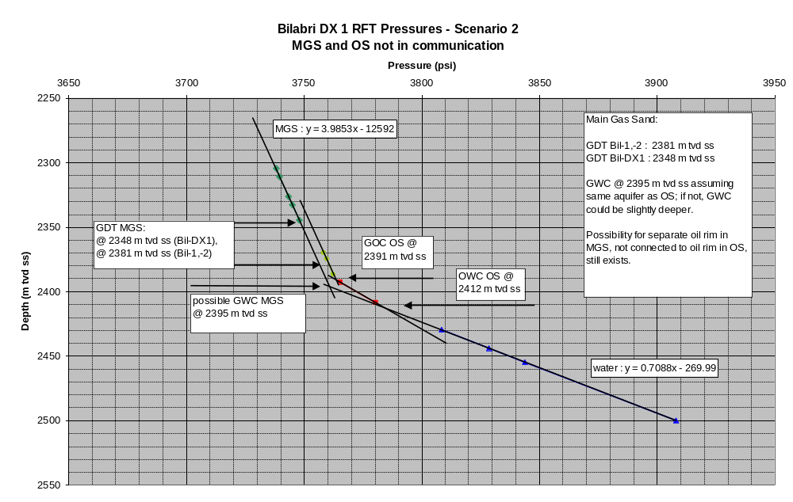
Pressure Plot – Separate pressure regimes

Slide 6

Cross section showing Oil-Gas distribution – Separate pressure regimes
MGS probably containing only gas
N
S
Bilabri-1
Bilabri-DX1
Gas
Oil
2303
C1.1
2331
C1.2
2367
C2.1
GWC: 2395
2404
C2.2
GOC: 2391
OWC: 2412
C2.3
Proximal
Macrostructure boundary fault

Slide 7

Map of MGS showing structure fully filled with Gas
Possible GWC = 2395 TVD ss
Amplitude anomaly outline
Possible producing well
Bilabri-4

Slide 8
Preliminary Volumes Shared OGS and OWC
Main Gas Sand and Oil Sand
Sand | Zones | BulkVolume [*10E6m^3] | Net Volume [*10E6m3] | STOIIP [*10E6Barrels] | GIIP [*10E9ft^3]
C 1.1 | Main Gas Sand | 249.87 | 224.89 | 70 | 530
C1.2 | ratty sand (Gas) | 109.35 | 32.81 | 9 | 42
 | shale | 40.79 | 0.00 | 0 | 0
C2.1 | Gas and Oil Sand | 17.58 | 15.82 | 10 | 35
C2.2 | ratty sand (Oil) | 1.59 | 0.80 | 0 | 1
C2.3 | Oil Sand (Water) | 0.00 | 0.00 | 0 | 0

